Slide 1
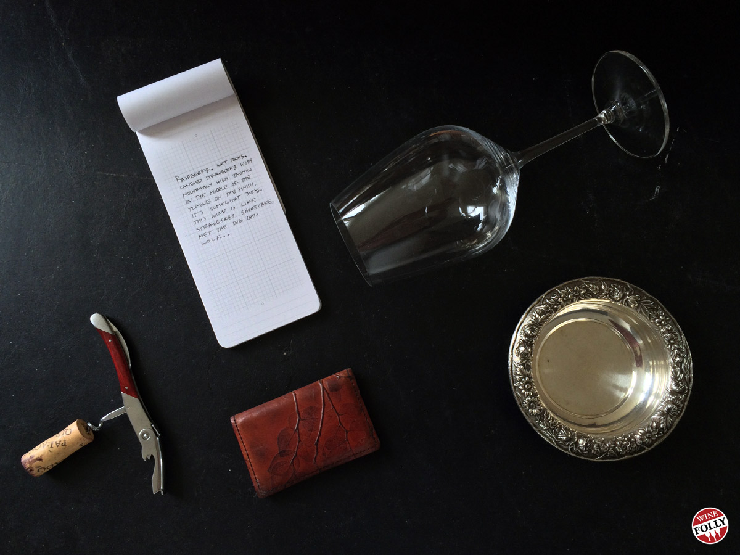
In Vino Veritas
GA Data Science Final Project
3/2/2016
Wen Lu

Slide 2
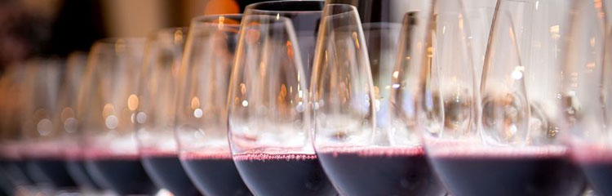
Data Source: UCI Machine Learning Repository Wine Quality Data Set http://mlr.cs.umass.edu/ml/datasets/Wine+Quality Two datasets: White Wine & Red Wine - 12 attributes - no missing values - sample size >1k

Slide 3

How to discern wine quality? Balance, Length, Depth, Complexity Wine making is considered an art. Is there a formula for a quality wine? What basic properties are the formula for a good wine? Do white wine and red wine share the same formula?

Slide 4
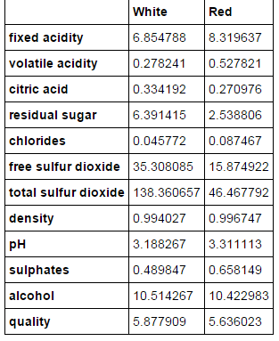
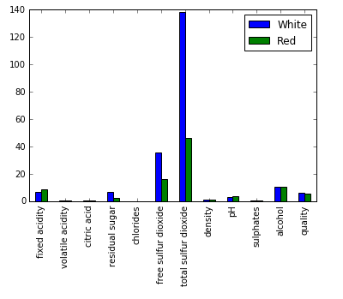

Slide 5
Next Steps
Data:
- Run feature correlations
- Scaling
Scenarios:
If two drastic different formulas →
additional: classification
If not huge difference →
work out a uniformed formula
Algorithms:
- Lasso
- Random Forest (importance score)
- PCA
- SVM
- Kmeans Clustering

